Slide 1
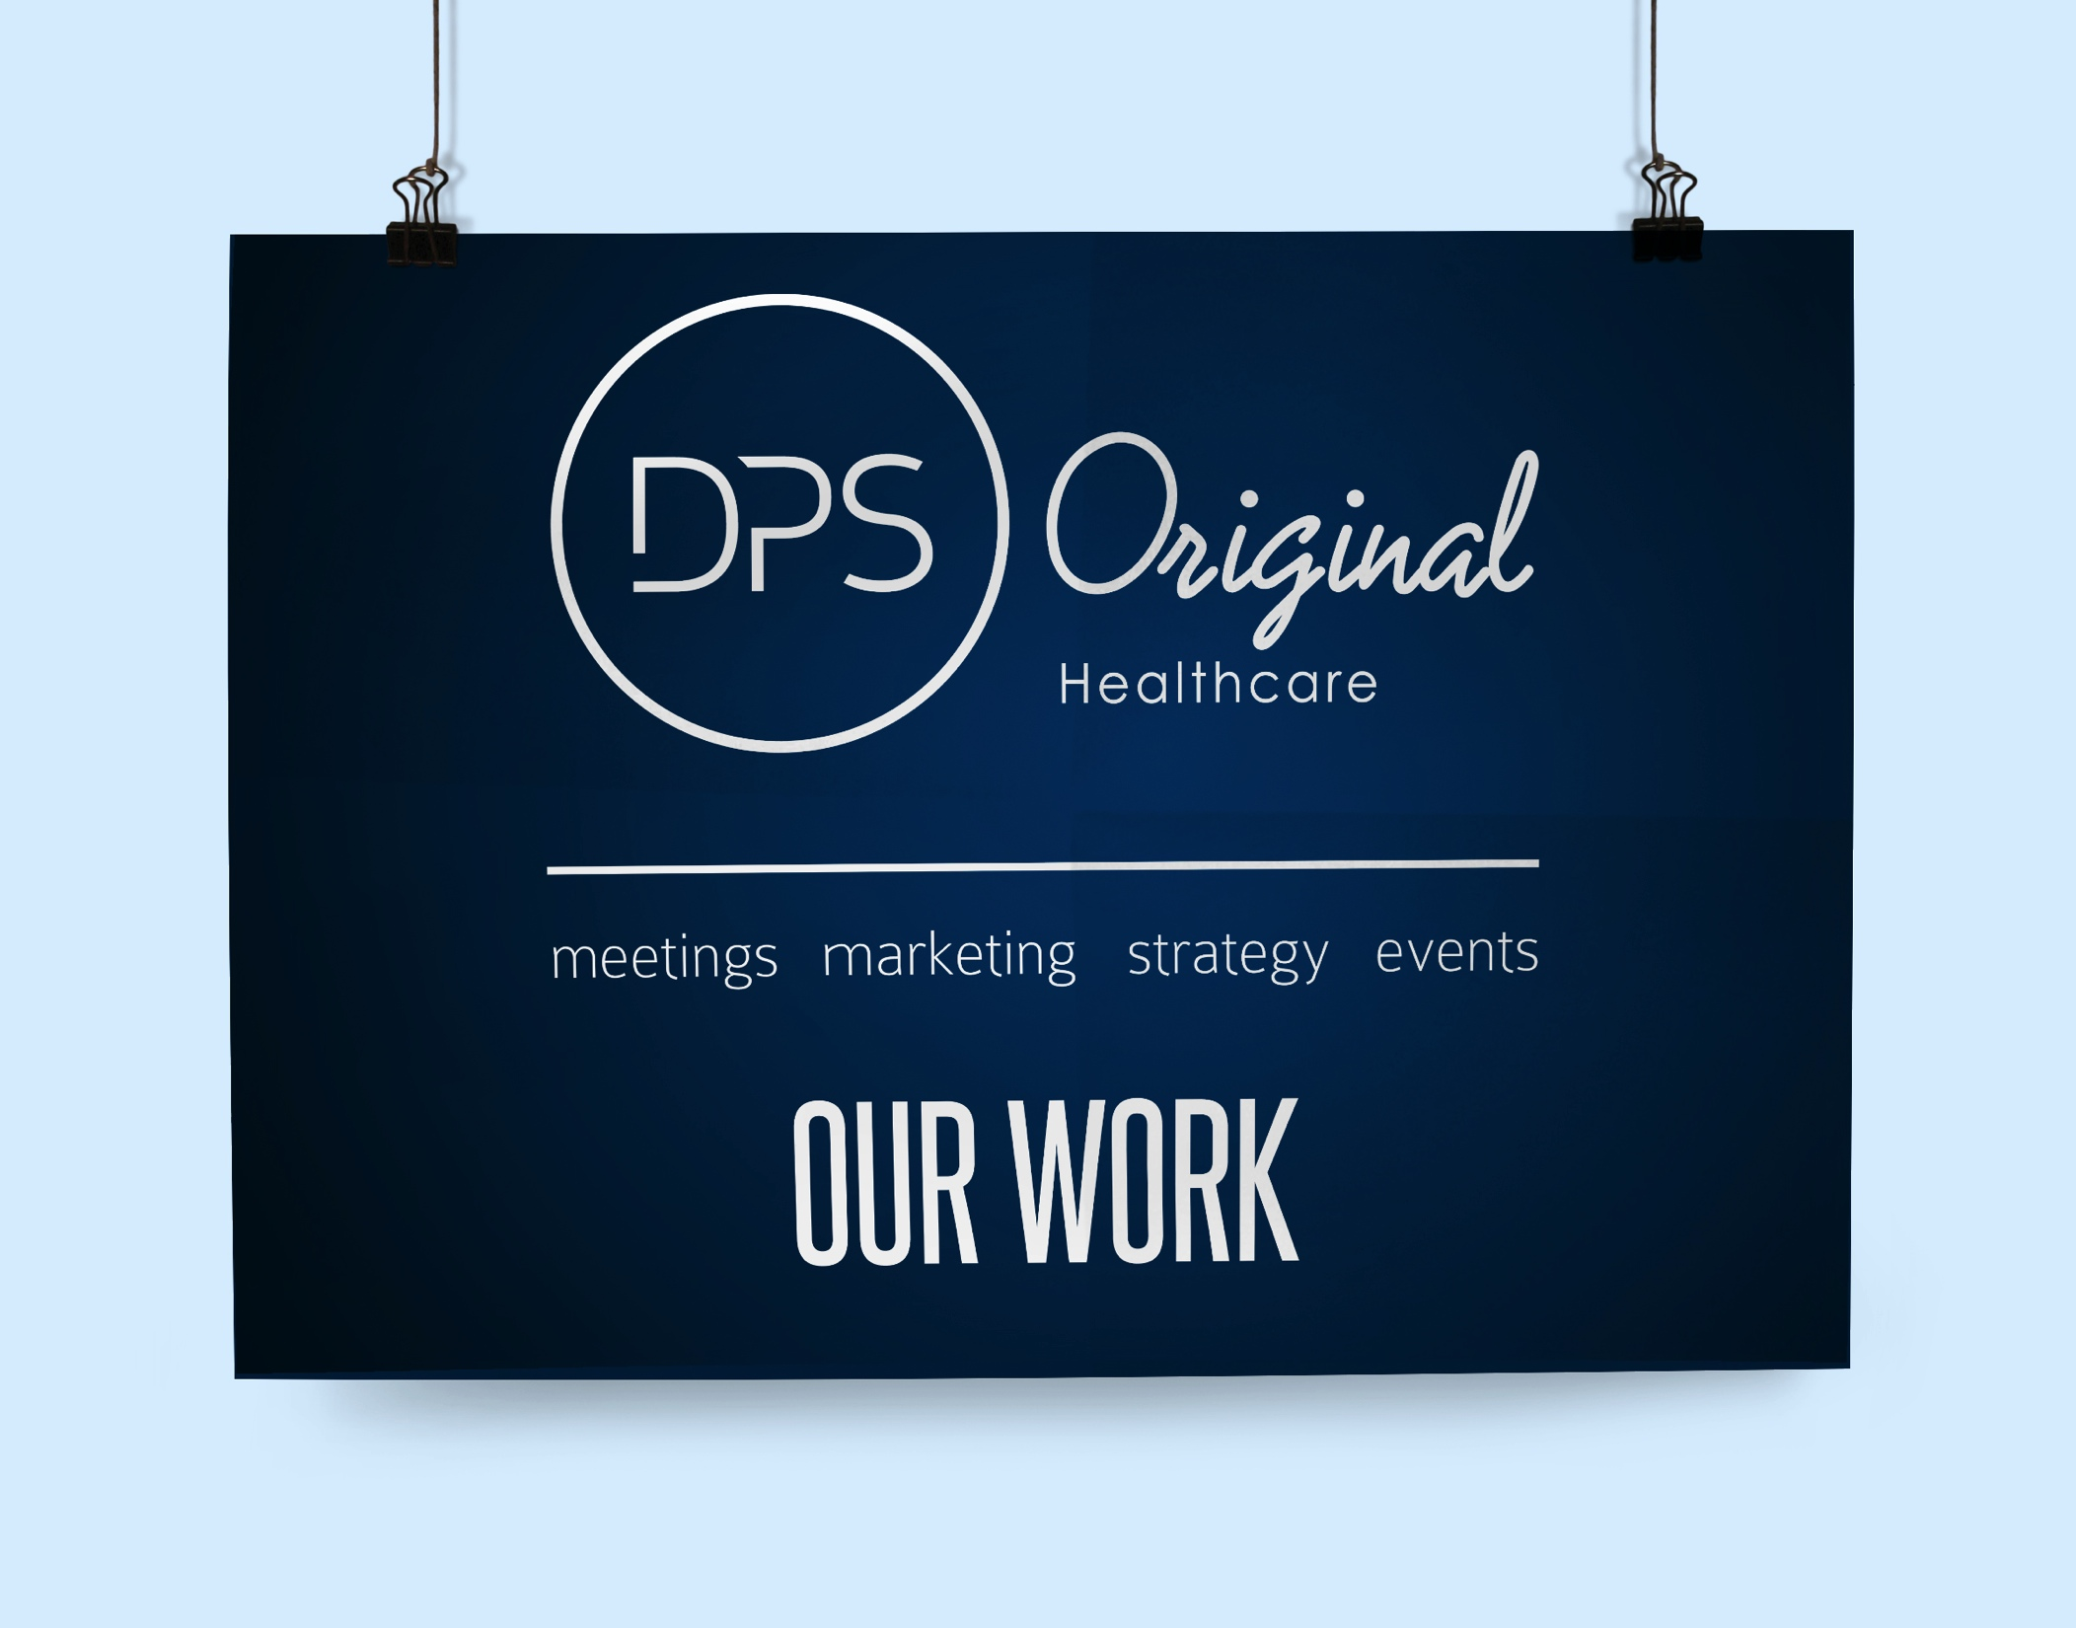

Slide 2
WE HAVE LEADING EXPERTISE & CREDIBILITY in the industry
We have directly partnered and worked with over 4,000 Specialists & Pediatricians:
Partnered with over 4,000 Healthcare Professionals
HCPs embrace our approach and become energized and increasing influential after partnering with us
Over 750 leading edge marketing & education programs delivered
Clients continue to seek our counsel and marketing support through HCP education and communications
Over 8,000 key selling messages communicated
Brands to stand out from the competition is the value we bring, ensuring it can be easily communicated to HCPs and their patients
Over 350 Advisory Board meetings
Maximizing strategic HCP participation in limited time is our goals to all of our advisory meetings

Slide 3

WE HAVE LEADING EXPERTISE & INDUSTRY KNOWLEDGE
The DPS Original Healthcare team is comprised of seasoned professionals, with an average of 15 years experience, schooled in different segments of the marketing and meetings environment.
HIGHLY SKILLED PEOPLE
MEDICAL EDUCATION PROFICIENCY
ADVISORY BOARDS EFFICIENCY
KOL ADVOCACY DEVELOPMENT
MARKETING & COMMUNICATIONS
MEETING FACILITATION
TRAIN-THE-TRAINER
MARKET RESEARCH
3
5
8
0
4
2
5
1
0
Major companies consulted
Blockbuster brands worked on
Marketing and communications projects delivered
Different global
markets served

Slide 4
WE HAVE extensive therapeutic category experience
P
h
D
ON STAFF
C
L
I
N
I
C
A
L
DATA COMPREHENSION
M
A
R
K
E
T
Research analysis

Slide 5
WE HAVE extensive therapeutic category experience
N
E
W
Product launches accomplishments
M
E
D
I
C
A
L
Education
Methodology Proficiency
P
L
A
N
Of action delivery

Slide 6

WE HAVE LEADING EXPERTISE & INDUSTRY KNOWLEDGE
The DPS Original Healthcare team is comprised of seasoned professionals, with an average of 15 years experience, schooled in different segments of the marketing and meetings environment.
EXTENSIVE therapeutic category experience
cardiovascular & respiratory management
MEDICAL DEVICE
ARTHRITIC PAIN MANAGEMENT
diabetes & pediatric care
neurology
urology
psychology

Slide 7
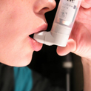






WE HAVE LEADING EXPERTISE & INDUSTRY KNOWLEDGE
The DPS Original Healthcare team is comprised of seasoned professionals, with an average of 15 years experience, schooled in different segments of the marketing and meetings environment.
HIGHLY SKILLED PEOPLE
NEUROLOGY
Medical Education Proficiency
KOL Advocacy Development
Advisory Boards Efficiency
Meeting Facilitation
Train-the-trainer
Marketing & Communications
Market Research
UROLOGY
PSYCHOLOGY
medical
device
DIABETES & PEDIATRIC
CARE
CARDIOVASCULAR & RESPIRATORY
ARTHRITIC PAIN MANAGEMENT

Slide 8
WE HAVE LEADING EXPERIENCE IN THE INDUSTRY
WE HAVE DIRECTLY PARTNERED WITH WELL OVER 1,500 SPECIALISTS
1
5
2
5
3
5
0
Average number of years of marketing and event strategic experience
Expertise of different therapeutic categories
KOL Training & Advisory Board meetings outlined & planned
4
2
5
8
0
0
0
Marketing Communications programs implemented
Key selling
messages delivered

Slide 9
WE HAVE BUILT STRONG KOL RELATIONSHIPS
We have a stake in our clients’ businesses. We strive to develop true value-added partnerships with our clients.
Our past and present client relationships include some of the world’s largest healthcare companies
We have built the most unique partnerships with Hospitals & Key Opinion Leaders across Canada, the US and Europe.
Our approach has proven itself over many long-term business relationships.

Slide 10
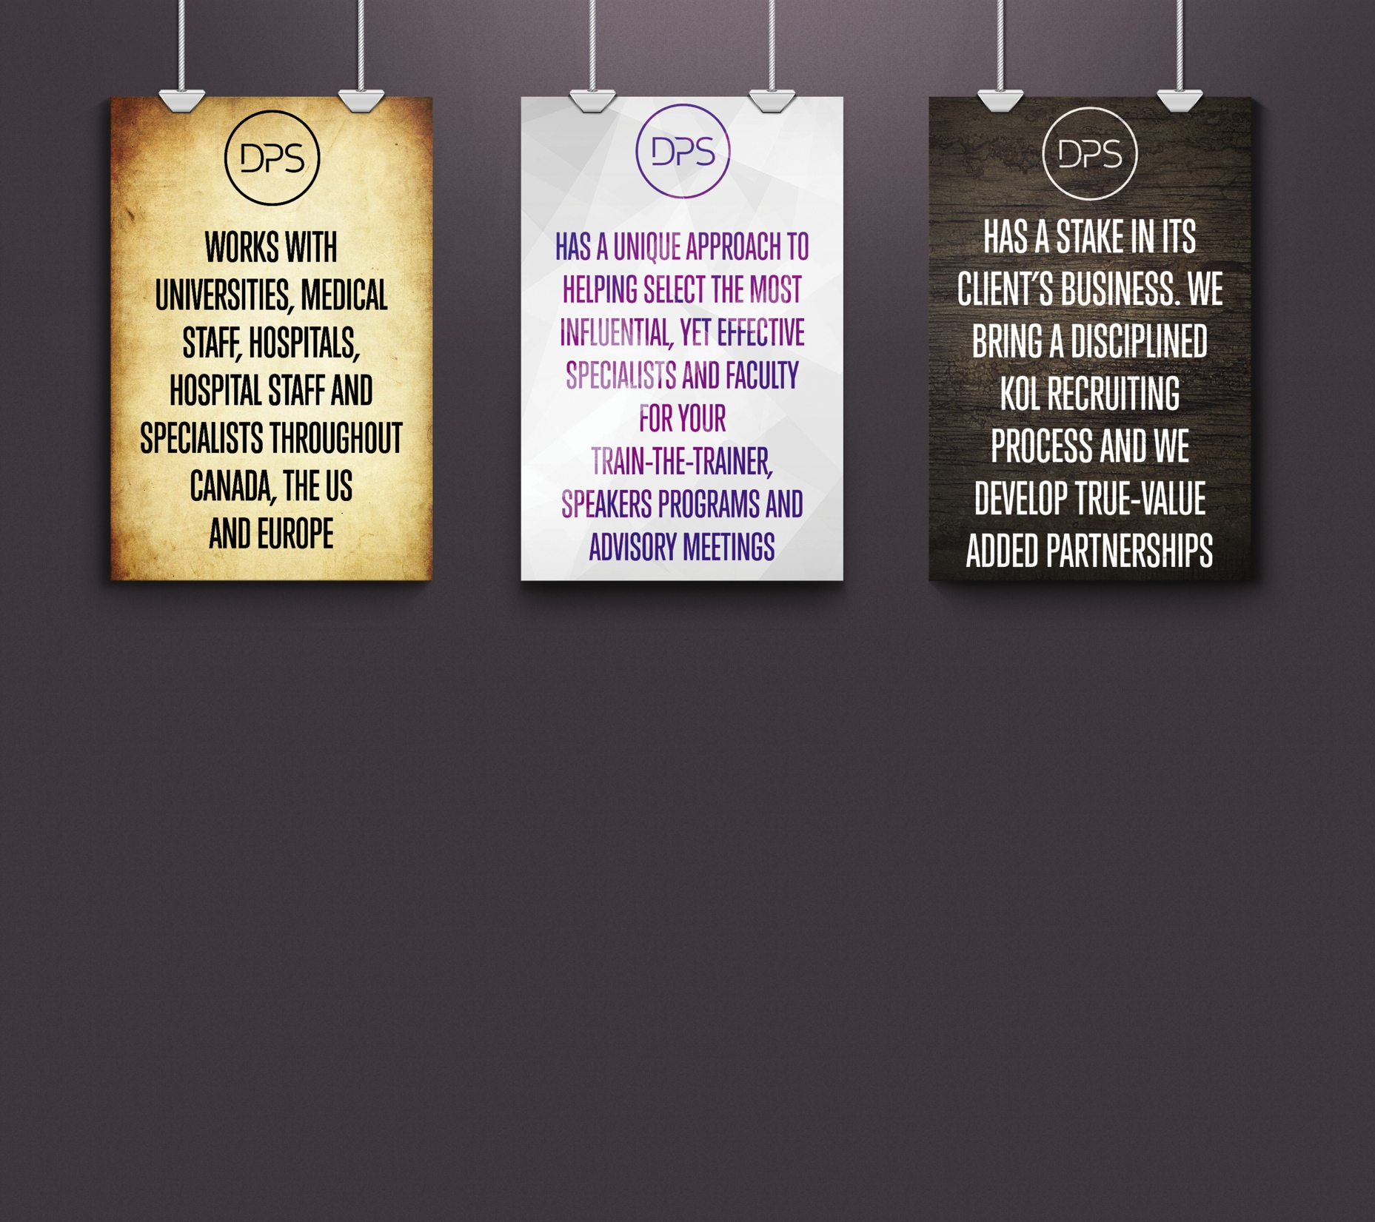
We bring faculty & kol recruitment

Slide 11
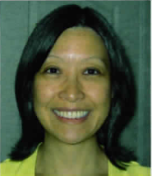
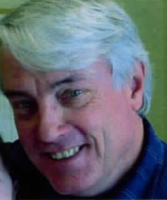
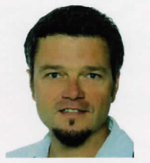
We bring faculty & kol recruitment
WE RECRUIT SEVERAL TOP PHYSICIANS FOR PROJECTS AND PROGRAMS
MARIANNA MITCHELL, MD, FRCPC
Dr. Mitchell is a Neonatologist and Consultant Pediatrician who has been working in the Oshawa /Whitby area for the past 20 years. Her undergraduate degree was in Nutrition and Food Chemistry from the University of Toronto. Her medical and pediatric training was from McMaster University in Hamilton. Her area of interest and previous research has been infant nutrition.
JACQUES SIMARD, MD, FRCPC
Dr. Simard is a Pediatrician, and a member of the Royal College since 1974. He is currently a pediatrician at the Centre pédatrique de Laval. He is a member of the board of the Association des pédiatres du Québec (APQ) and also a member of their CME committee. He is a speaker and a member of many Pharmaceutical Advisory Boards since the 1990s.
mark kovacs, MD, faap
Dr. Simard is a Pediatrician, and a member of the Royal College since 1974. He is currently a pediatrician at the Centre pédatrique de Laval. He is a member of the board of the Association des pédiatres du Québec (APQ) and also a member of their CME committee. He is a speaker and a member of many Pharmaceutical Advisory Boards since the 1990s.

Slide 12
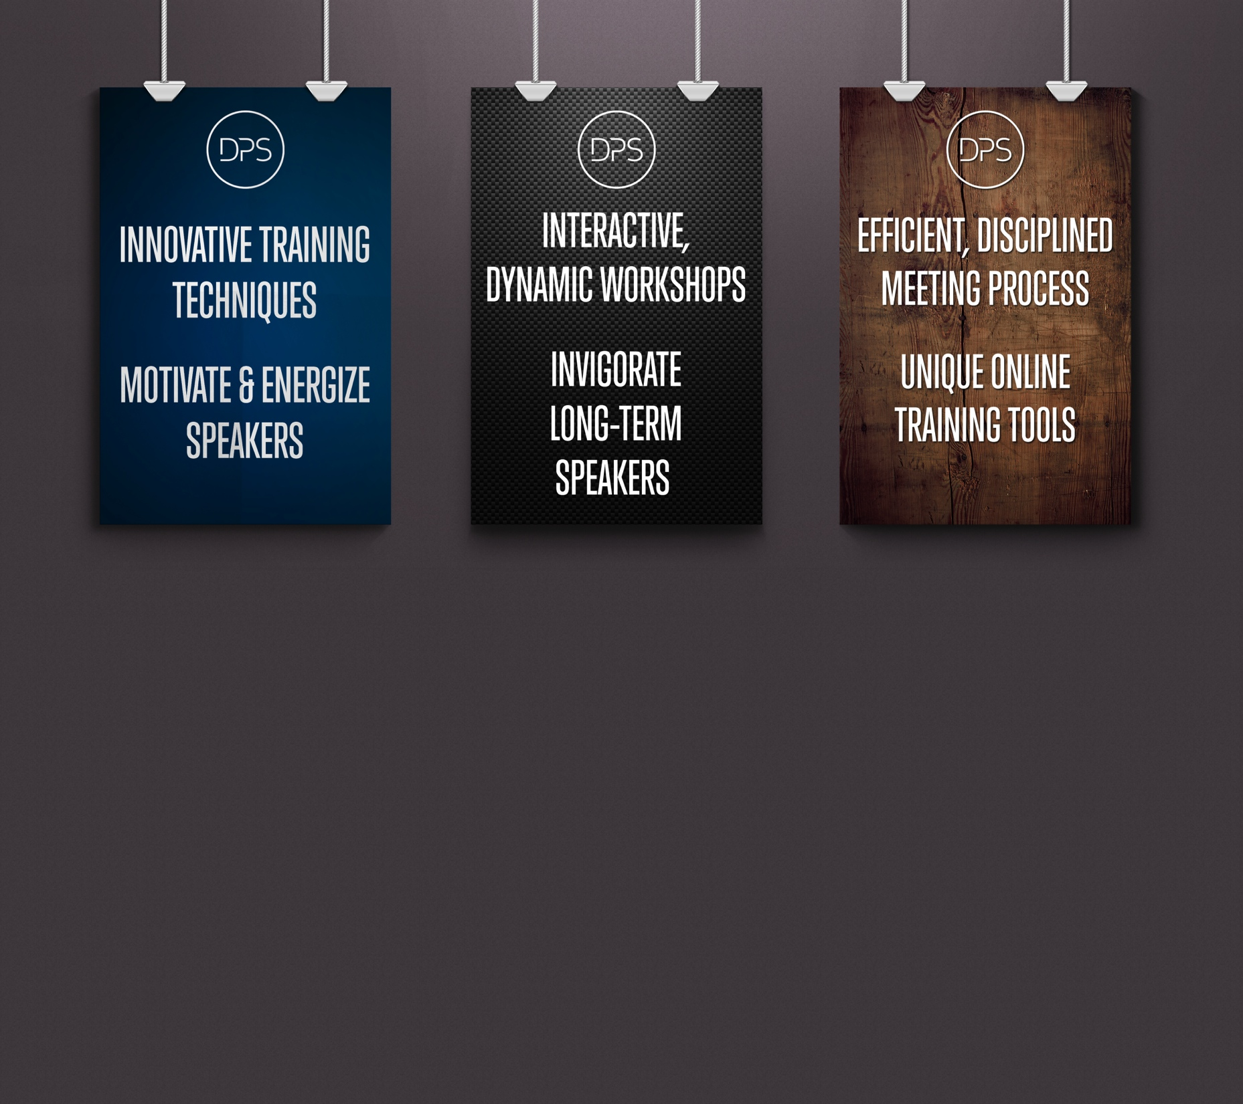
WE EXCEL WITH TRAIN THE TRAINER EXPERTISE
Our passion is to motivate, energize, coach and train Specialists to convey the science but also the key messages to their HCP peers.
Our work is not done until all Speakers have perfected exactly that – to convey the key messages in the most effective, engaging, and practical ways.

Slide 13
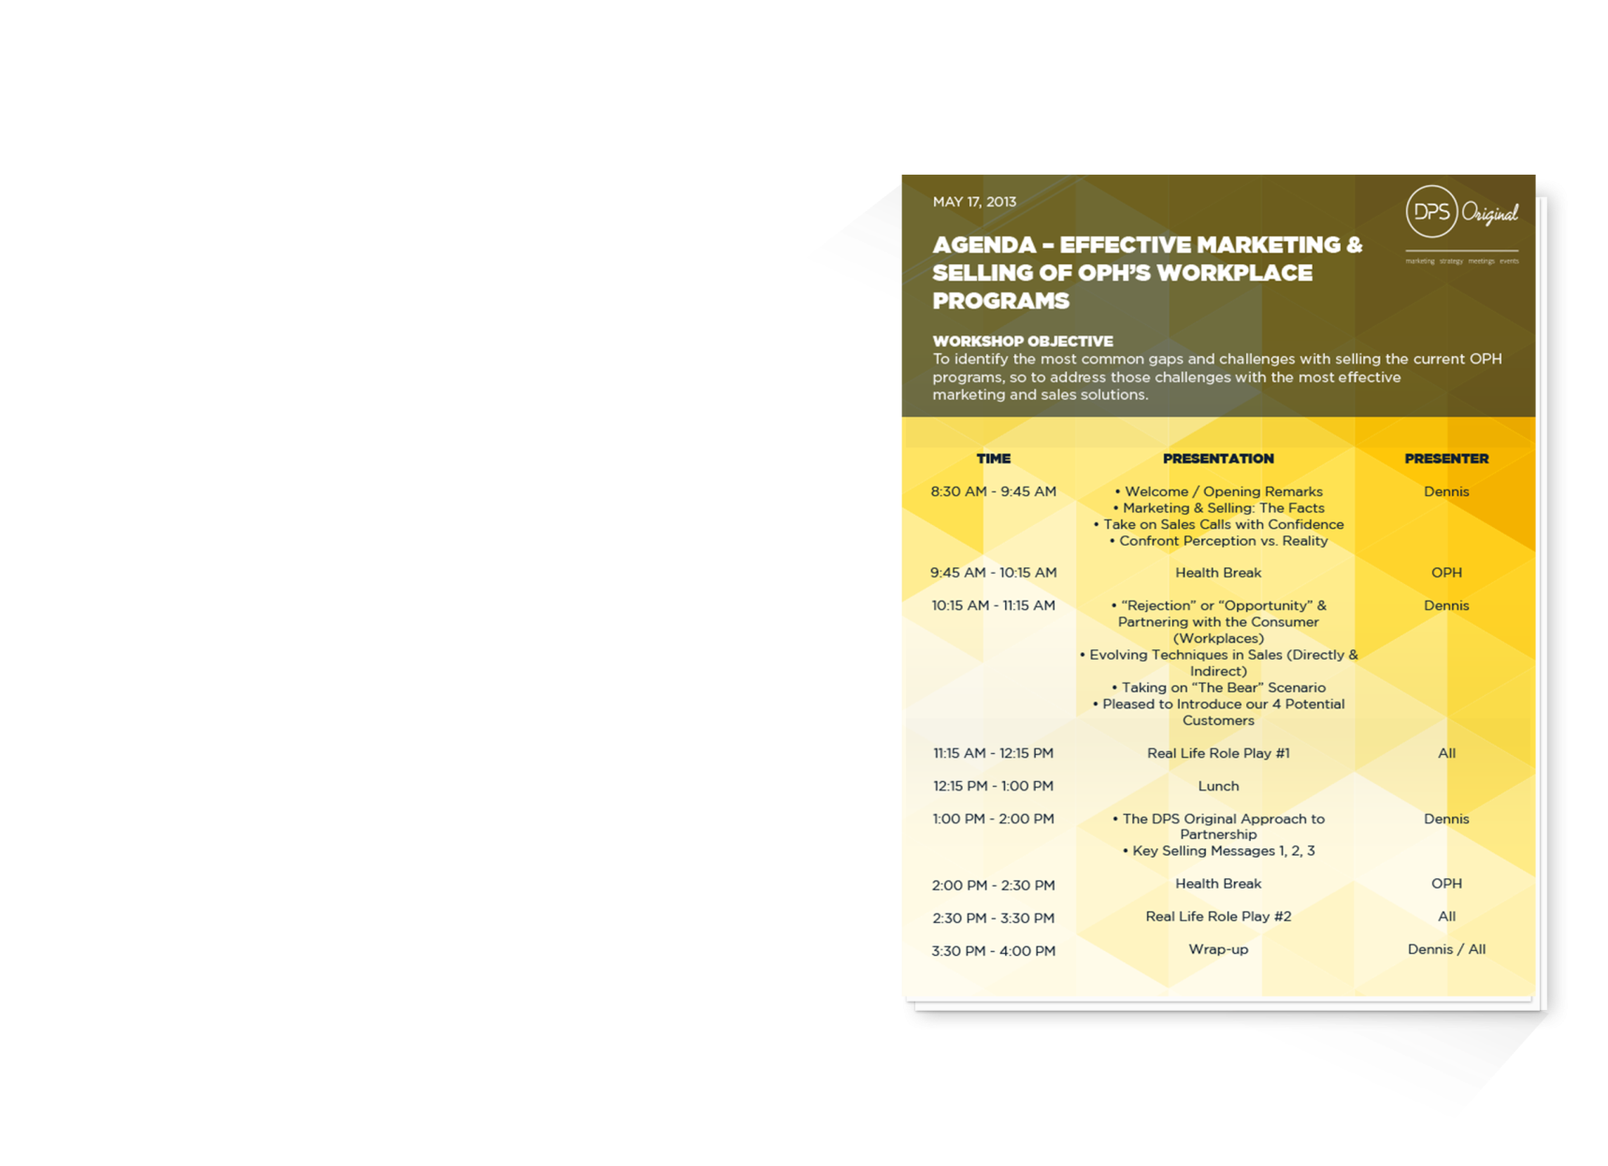
WE BRING IMPROVED MEETING EFFICIENCIES
OUR PASSION IS TO MOTIVATE, ENERGIZE AND COACH SPECIALISTS TO BETTER UNDERSTAND THE SCIENCE, BUT ALSO KEY MESSAGE
A DAY IS A TERRIBLE THING TO WASTE!
You've got one day and one meeting room to do it all: address multiple agendas, handle a cross-functional team of different personalities, and develop prioritized and actionable items that ensure alignment within the group. At DPS Original (Healthcare), our meeting facilitation services can help you win the hearts and minds of your cross-functional team.
No matter what type of meeting – strategic, logical, or creative – DPS Original’s professional facilitation services are tailored to meet your needs. Our disciplined approach to meeting facilitation ensures you achieve the day's objectives while building trust and a sense of collective ownership among team members.

Slide 14
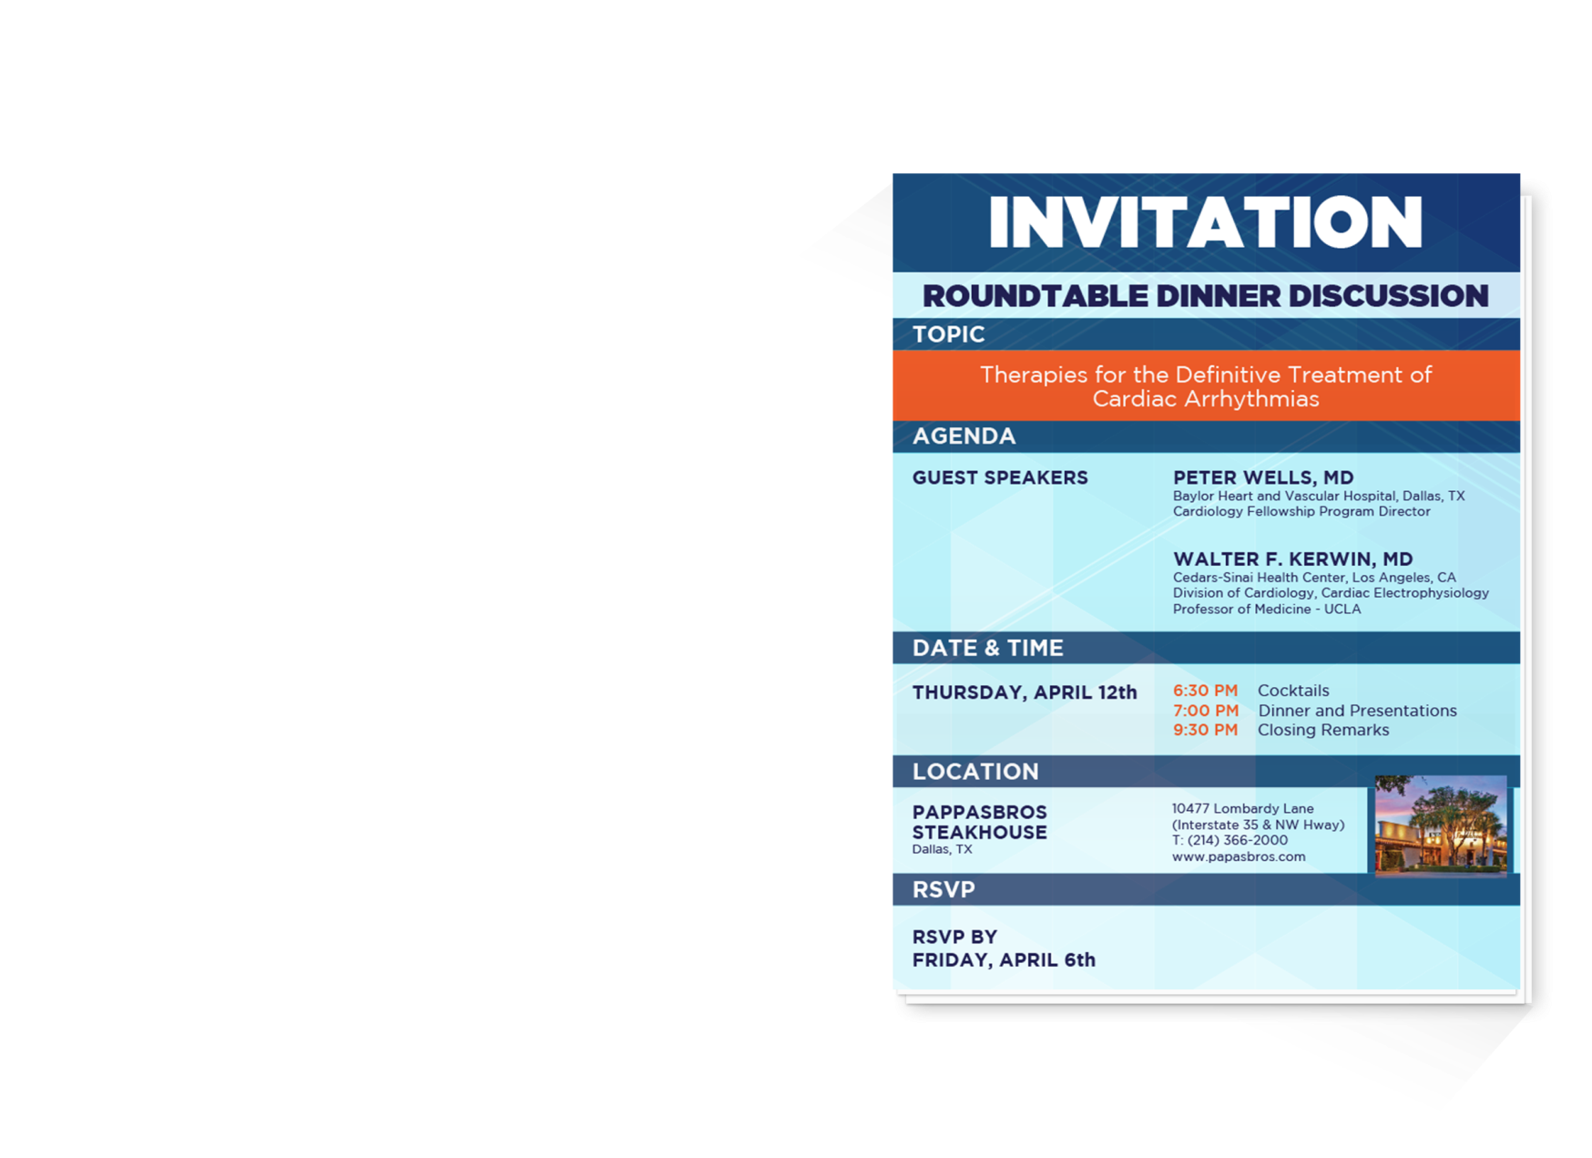
WE BRING STRATEGIC TRAINING EXPERTISE
WE RECRUIT SEVERAL TOP PHYSICIANS FOR PROJECTS AND PROGRAMS
Our disciplined approach is a blend of strategic and creative thinking while our process is both a science and an art; grounded in discipline, inspired by non-conformity. We challenge our clients to take a hard look at the brand, while we create the most effective Ad Board, Speakers Training and Speakers Forum meetings to meet those challenges.
A DPS Original (Healthcare) advisory board will find better ways to engage and challenge key opinion leaders.
We design unique and interactive sessions that are both evocative and provocative. We take participants out of their comfort zones and engage them to look at your brand in a different way, leading to actionable marketing intelligence.
Our work is only results-oriented. Specific to DPS Original, we also follow-up after programs are implemented to ensure results are truly being achieved.

Slide 15
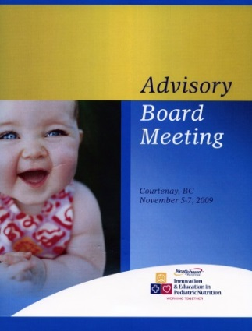

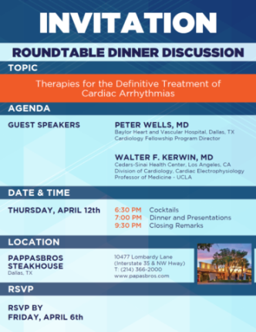
WE ONLY CREATE ENGAGING ADVISORY BOARDS & ROUNDTABLES
We design unique and interactive sessions that are both evocative and provocative.
At DPS Original Healthcare, we find better ways to engage and challenge key opinion leaders:
1
0
0
Advisory boards might be common practice... but why practice them in a common way?
We design unique and interactive sessions that are both evocative and provocative. We take participants out of their comfort zones and engage them to look at your brand in a different way, leading to actionable marketing intelligence.
Over
Ad Boards

Slide 16
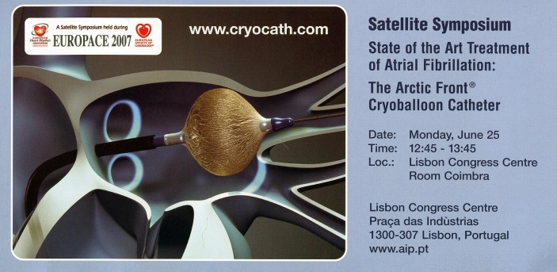

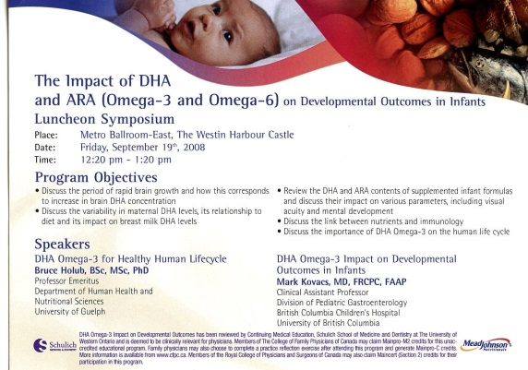
WE SELL OUT SYMPOSIA & SPEAKERS FORUM
WE FIND BETTER WAYS TO ENGAGE AND CHALLENGE KEY OPINION LEADERS
We bring the highest level of confidence to clients with our wide range of business solutions:
SELL-OUT:
Over 1,200 Cardiologists and
Cardio-thoracic surgeons
SELL-OUT:
800 pediatricians and General Physicians
SELL-OUT:
Over 1,000 Nurse Practitioners, Dieticians and Hospital Staff
SELL-OUT:
Over 1,200 Cardiologists and
Cardio-thoracic surgeons
We design unique and interactive sessions that are both evocative and provocative. In the past few years, we have had the pleasure of developing and managing major symposia across the United States and Canada, Portugal, the UK, Sweden and others.

Slide 17

We ARE…
Specialists
Experienced
Unique
Creative
Credible
Experts
Partners

